Slide 1
Question & Answer

Slide 2
Practice 1
Question and Answer
Text + Question ➔ Answer
Encoder-Decoder Model
Encoder(2 Model)
Story Encoder
Question Encoder
Decoder
Answer
Question
Answer
Story

Slide 3
Practice 1: Q&A
Encoder(Story)
Story 전체에 대해서 LSTM으로 Encoding
Encoder(Question)
Question에 대해서 LSTM으로 Encoding
Decoder(Answer)
Story Encoding 값과 Question Encoding 값을 이용하여 Answer 예측
Question
Answer
Story

Slide 4
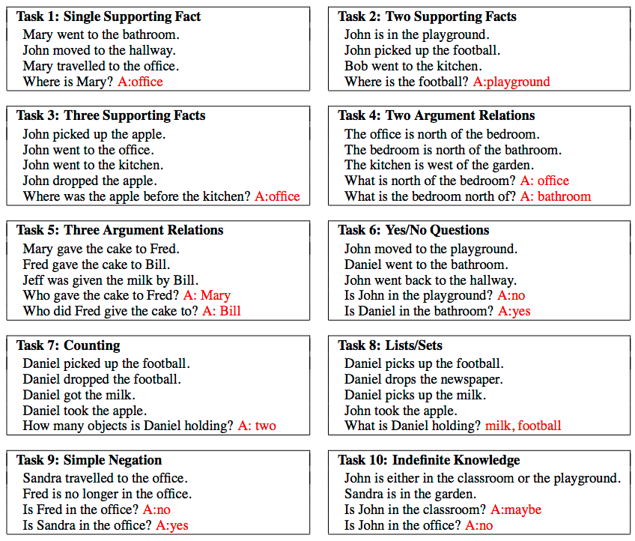
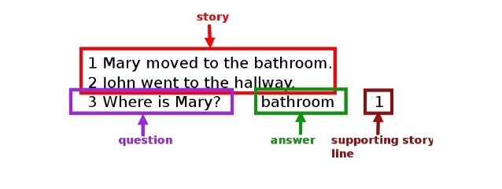
Practice 1: Q&A
Dataset
Babi dataset
1000 questions for each task (20 task)
Story + question + answer

Slide 5
Practice 1: Q&A
Dataset
How to preprocessing babi Data?
1 Mary moved to the bathroom . 2 John went to the hallway . 3 Where is Mary ? bathroom 1 4 Daniel went back to the hallway . 5 Sandra moved to the garden . 6 Where is Daniel ? hallway 4 7 John moved to the office . 8 Sandra journeyed to the bathroom . 9 Where is Daniel ? hallway 4 10 Mary moved to the hallway . 11 Daniel travelled to the office . 12 Where is Daniel ? office 11 13 John went back to the garden . 14 John moved to the bedroom . 15 Where is Sandra ? bathroom 8

Slide 6
Practice 1: Q&A
Dataset
Code
def read_qa(self, file_name): with open(file_name, "r") as fin: lines = fin.readlines() text = [] for line in lines: tabs = line.split("\t") words = line.split() if int(words[0]) == 1: text = [] else: text = list(text) # text if len(tabs) < 2: for i in range(1, len(words)): word = words[i] if word not in self.w2idx: self.w2idx[word] = len(self.w2idx) text.append(self.w2idx[word])
1 Mary moved to the bathroom . 2 John went to the hallway . 3 Where is Mary ? bathroom 1 4 Daniel went back to the hallway . 5 Sandra moved to the garden . 6 Where is Daniel ? hallway 4 7 John moved to the office . 8 Sandra journeyed to the bathroom . 9 Where is Daniel ? hallway 4 10 Mary moved to the hallway . 11 Daniel travelled to the office . 12 Where is Daniel ? office 11 13 John went back to the garden . 14 John moved to the bedroom . 15 Where is Sandra ? bathroom 8
Tab이 있으면 Question, Answer 데이터

Slide 7
Practice 1: Q&A
Dataset
Code
else: q = [] for i in range(1, len(tabs[0].split())): word = words[i] if word not in self.w2idx: self.w2idx[word] = len(self.w2idx) q.append(self.w2idx[word]) answer = tabs[1].split()[0] if answer not in self.w2idx: self.w2idx[answer] = len(self.w2idx) if len(text) <= self.max_t_len and len(q) <= self.max_q_len: np_text = np.zeros((1, self.max_t_len), dtype=np.int32) for i, o in enumerate(text): np_text[0][i] = o np_qst = np.zeros((1, self.max_q_len), dtype=np.int32) for i, o in enumerate(q): np_qst[0][i] = o self.T = np.append(self.T, np_text, axis=0) self.Q = np.append(self.Q, np_qst, axis=0) self.A = np.append(self.A, self.w2idx[answer]) self.t_len = np.append(self.t_len, len(text)) self.q_len = np.append(self.q_len, len(q))
Mary moved to the bathroom .
John went to the hallway . Where is Mary ? Bathroom
Data 1
Mary moved to the bathroom .
John went to the hallway .
Daniel went back to the hallway .
Sandra moved to the garden . Where is Daniel ? hallway
Data 2
Mary moved to the bathroom . John went to the hallway . Daniel went back to the hallway . Sandra moved to the garden . John moved to the office . Sandra journeyed to the bathroom . Where is Daniel ? hallway
Data 3

Slide 8
Practice 1: Q&A
Embedding Layer (Model)
Initialize Variable
class QAdata(object): def __init__(self, path="../../dataset/babi/", max_q_len=20, max_t_len=20): self.path = path self.w2idx = {"<eos>": 0} self.max_q_len = max_q_len self.max_t_len = max_t_len self.T = np.zeros((0, self.max_t_len), dtype=np.int32) self.Q = np.zeros((0, self.max_q_len), dtype=np.int32) self.A = np.zeros((0), dtype=np.int32) self.t_len = np.zeros((0), dtype=np.int32) self.q_len = np.zeros((0), dtype=np.int32)

Slide 9
Practice 1: Q&A
Encoder(Story)
Story 전체에 대해서 LSTM으로 Encoding
Encoder(Question)
Question에 대해서 LSTM으로 Encoding
Decoder(Answer)
Story Encoding 값과 Question Encoding 값을 Dense Network를 이용하여 Answer 예측
Question
Answer
Story

Slide 10
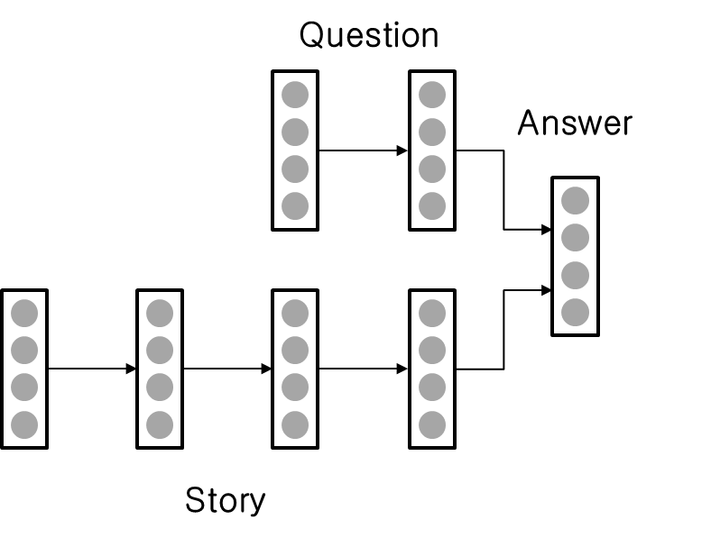
Practice 1: Q&A
Setup Layers (Story Encoder Model)
Code
tf.variable_scope
Bidirectional_dynamic_rnn 내 LSTM cell을 호출하면 LSTM 변수가 생성되는데, 여러 개의 Bidirectional_dynamic_rnn 을 사용하려면 tf.variable_scope를 이용하여 변수를 구분해주어야함
# Bi-direction LSTM for Text
with tf.variable_scope("text_lstm"): (self.t_out, (t_fw_state, t_bw_state)) = bidirectional_dynamic_rnn( LSTMCell(self.hidden_dim), LSTMCell(self.hidden_dim), inputs=self.t_emb, sequence_length=self.t_len, dtype=tf.float32)

Slide 11
Practice 1: Q&A
Setup Layers (Question Encoder Model)
Code
# Bi-direction LSTM for Question with tf.variable_scope("question_lstm"): (self.q_out, (q_fw_state, q_bw_state)) = bidirectional_dynamic_rnn( LSTMCell(self.hidden_dim), LSTMCell(self.hidden_dim), inputs=self.t_emb, sequence_length=self.t_len, dtype=tf.float32)

Slide 12
Practice 1: Q&A
Setup Layers (Answer Decoder Model)
Code
Story Encoder의 최종 hidden state + Question Encoder의 최종 hidden state 를 이용하여 Answer 예측
self.text_question = tf.concat([t_fw_state.h, t_bw_state.h, q_fw_state.h, q_bw_state.h], 1) self.out_layer = Dense(self.vocab_size, name='out_layer') self.word_prob = self.out_layer(self.text_question) self.output = tf.cast(tf.argmax(self.word_prob, 1), tf.int32)

Slide 13
Practice 1: Q&A
Build Loss
Code
Build Optimizer
Code
def build_loss(self): self.cross_entropy = tf.nn.sparse_softmax_cross_entropy_with_logits(labels=self.A, logits=self.word_prob) self.loss = tf.reduce_mean(self.cross_entropy)
def build_opt(self): # define optimizer optimizer = tf.train.AdamOptimizer(learning_rate=self.learning_rate) grad, var = zip(*optimizer.compute_gradients(self.loss)) # gradient clipping def clipped_grad(grad): return [None if g is None else tf.clip_by_norm(g, 2.5) for g in grad] if self.use_clip: grad = clipped_grad(grad) self.update = optimizer.apply_gradients(zip(grad, var))

Slide 14
Practice 1: Q&A
Train Model and Result
Code
for it in range(0, 10000): T, Q, A, t_len, q_len = data.get_train(BATCH_SIZE) feed_dict = {model.T: T, model.Q: Q, model.A: A, model.t_len: t_len, model.q_len: q_len} loss, _ = sess.run([model.loss, model.update], feed_dict=feed_dict) avg_loss += loss it_cnt += 1 if it % it_log == 0: print(" it: {:4d} | loss: {:.3f} - {:.2f}s".format(it, avg_loss / it_cnt, time.time() - start_time)) avg_loss, it_cnt = 0, 0 if it % it_test == 0 and it > 0: test_model() if it % it_save == 0 and it > 0: model.save(sess) if it % it_sample == 0 and it > 0: sample_test()

Slide 15
Practice 1: Q&A
Result
it: 4860 | loss: 0.977 - 738.82s
it: 4870 | loss: 0.943 - 740.29s
it: 4880 | loss: 1.009 - 741.65s
it: 4890 | loss: 0.941 - 743.08s
it: 4900 | loss: 0.945 - 744.50s
* test loss: 1.097 | acc: 0.475
- Given text: John journeyed to the garden . Sandra travelled to the hallway . Mary went back to the hallway . John went to the bathroom . John journeyed to the kitchen . Daniel went back to the kitchen . Daniel went to the garden . Mary went to the bedroom . John went to the garden . John went to the office . <eos>
- Question: Where is John ? <eos>
- Answer: office / office (ground-truth)
it: 4910 | loss: 0.886 - 746.35s
it: 4920 | loss: 0.872 - 747.77s

